Slide 1
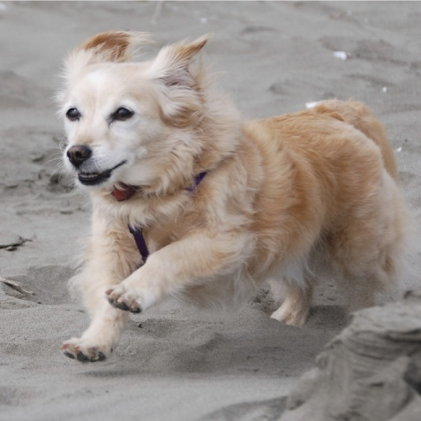
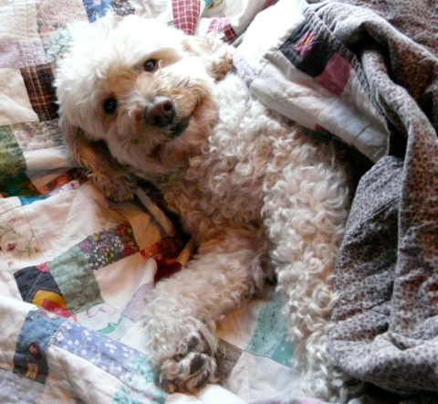
A Mixed Methods Exploratory Study of Alleged
Telepathic Interspecies Communication with Domestic Dogs
(Canis lupus familiaris)
Deborah L Erickson, PhD

Slide 2
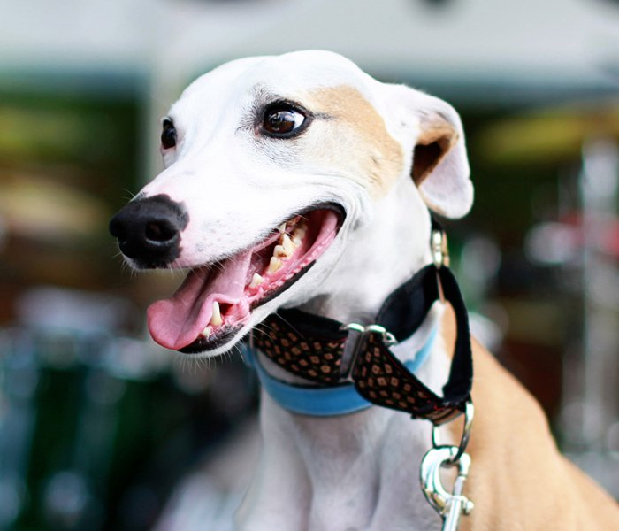
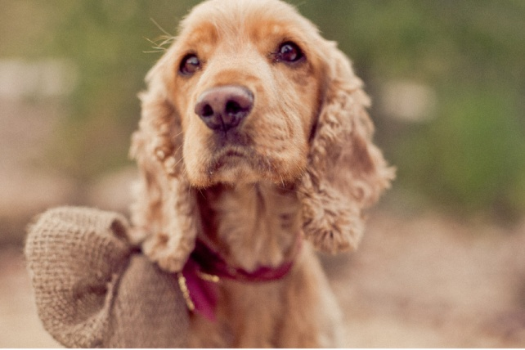
Introduction
“Lots of people talk to animals,” said Pooh.
“Not very many listen, though,
that’s the problem.”
(Hoff B., 1982, The Tao of Pooh, p 29)

Slide 3
Introduction
A small grey cat named Joey
Psychophysiological coherence
The brain / heart connection
Calming the mind and emotions
Quieting the mind enables telepathic connections
My intention is to change the world

Slide 4
Methods
Mixed-methods approach.
Quantitative rating scale 1 (entirely inaccurate) to 6 (entirely accurate)
Qualitative comments on accuracy of the information received from the canines as judged by the guardians.

Slide 5
Participants
Planned for 20 sessions.
Email forwarding resulted in an overwhelming response:
  Over 130 responses were received
  Research expanded from 20 to 50 sessions
  80+ people were turned down
Each domestic canine was at least one year old that had lived with the guardian for at least one year.

Slide 6
Human Participants
Guardians & canines in 36 different cities:
Astoria, OR | North Bend, WA
Auburn, WA | Olympia, WA
Beaverton, OR | Port Orchard, WA
Bellevue, WA | Portland, OR
Chehalis, WA | Raleigh, NC
Colville, WA | Sarasota, FL
Eastsound, WA | Seatac, WA USA
Federal Way, WA | Seattle, WA
Friday Harbor, WA | Sedro Woolley, WA
Ft Lauderdale, FL | Snohomish, WA
Gig Harbor, WA | Spokane, WA
Greensburg, PA | St Johnsbury, VT
Lacey, WA | Tacoma, WA
Lampe, MO | Tigard, OR
Las Vegas, NM | Vashon, WA
Miama, FL | Winlock, WA USA
N Huntingdon, PA | Woodinville, WA
Newport Beach, CA | Yelm, WA

Slide 7
Canine Participants:44 Breeds/Mixed Breeds:
American Bulldog/Boxer mix | Kuvasz/Dalmation mix
Australian Labradoodle | Labradoodle mix
Basset | Maltese mix
Bearded Collie/Afghan | Maltipoo mix
Black Lab | Miniature Pinscher
Black Lab mix | Miniature Schnauzer
Black Lab/Dachshund | Mixed
Lab/Beagle | Papillon
Lab/Pit bull mix | Pit Bull cross
Yellow Lab | Pug
Border Collie | Retriever, Shiba Inu mix
Boston Terrier | Sheltie
Cavalier King Charles Spaniel | Shiba Inu
Dachshund/Chihuahua mix | Shiloh Shepherd
Dane-Lab-Husky mix | Shitzu/Bichon mix
English Cocker Spaniel | Soft-Coated Wheaten Terrier
German Shorthair Pointer | Spitz mix
Golden (some Lab) | St. Bernard/Brazilian Mastiff mix
Golden Retriever | Standard Poodle
Golden Retriever mix | Tibetan Mastiff
Jack Russell | Whippet

Slide 8
Process
Participants agreed to online Consent to Participate.
Sent photos of canine(s) to researcher via email.
Session scheduled & conducted
  Five standard questions of all canines
  Remainder of session open to guardian questions.
All information transferred to web survey form.
Researcher sent link to survey form and recorded session.
Guardian followed email link and completed survey form; 100% completion.

Slide 9
Standard Questions
(1) How many humans do you live with?
(2) Have you lived with your guardian since you were very young?
(3) What is your favorite food or treat you get now?
(4) What do you like most about your life?
(5) What would you change about your life?

Slide 10
Process
Guardians asked to rate accuracy of information telepathically received on a 1 (low accuracy) to 6 (high accuracy) Likert scale:
Average accuracy rate
across 50 sessions: 5.12
1 | 2 | 3 | 4 | 5 | 6
Entirely Inaccurate |  | Moderately Inaccurate | Moderately Accurate |  | Entirely Accurate

Slide 11
Sessions/Session Times
50 sessions
All scheduled on a Friday, Saturday, or Sunday.
A total of 21 days, with up to 5 sessions scheduled in a single day.
  Total time for all sessions was 26.5 hours.
  Researcher’s preparation time minimum of 15 minutes; another 12.5 hours.
  39 total hours for the research.

Slide 12
Overall Session Ratings

Slide 13
Length of Session Accuracy
Session Length (Min) | # of Sessions | Average Rating
14 to 20 | 6 | 4.50
21 to 30 | 20 | 5.15
31 to 40 | 15 | 5.13
41 to 50 | 4 | 5.25
51 to 60 | 5 | 5.60
Total | 50

Slide 14
Length of Session Accuracy
50

Slide 15
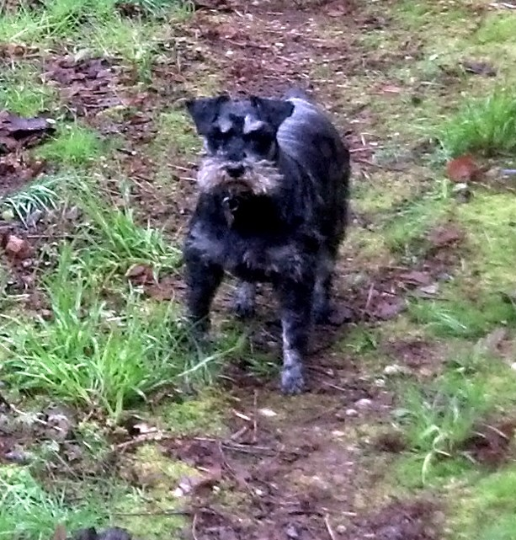
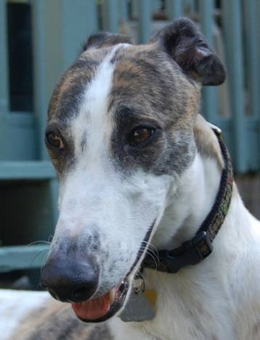
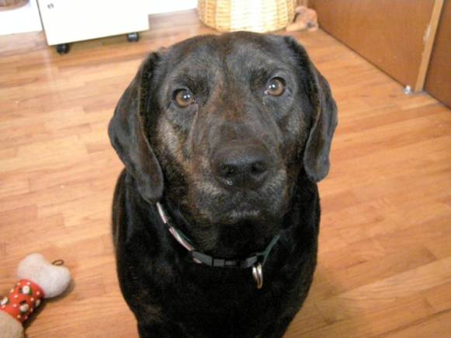
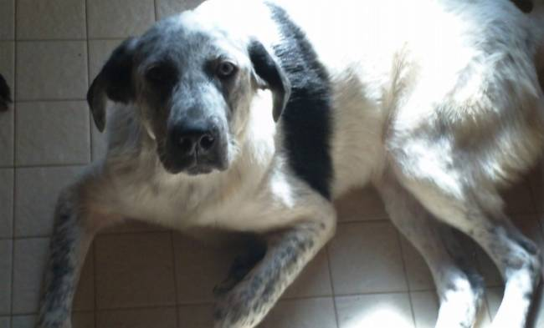
Surprising Guardian Questions
Why do you inhale your food?
Why is she afraid of being trapped?
Why does she bark at Charlie? Does she know he lives here?
Why does he choose to not get on the couch, even when invited?
Why won’t he get on the wooden deck?

Slide 16
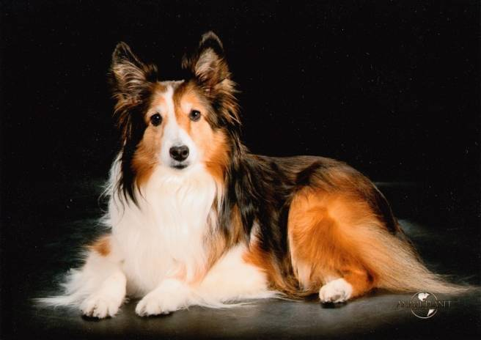
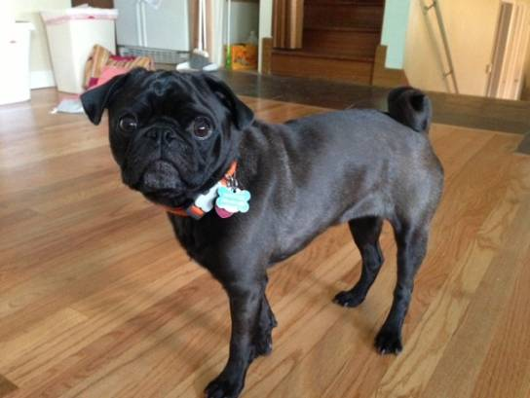
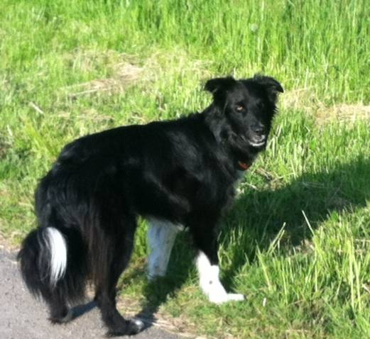
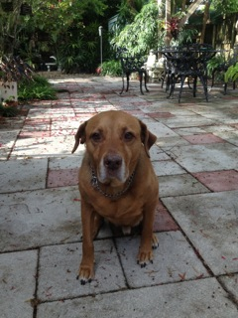
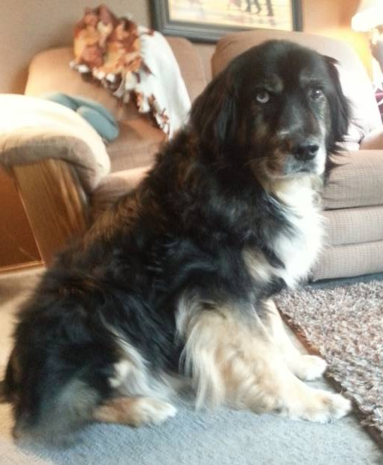
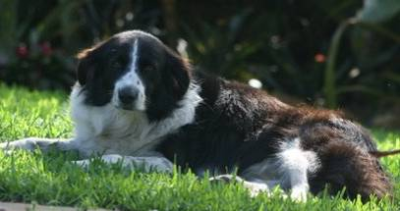
Surprising Guardian Questions
Why is she fighting having her teeth brushed?
Why is he so afraid of my husband in a white t-shirt?
Why does he attack the television?
Why does he eat chicken/goose/fox poop?
Why does he bite the giant turtle’s legs?
Why does he bite people?

Slide 17
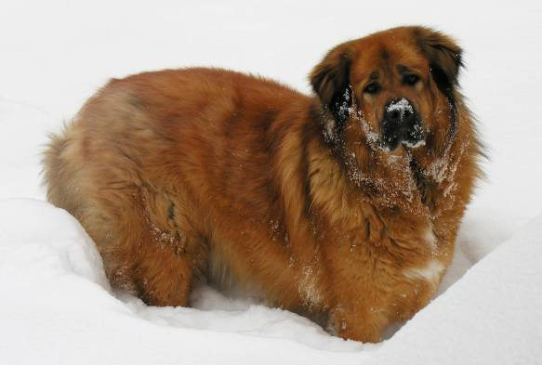
Common Themes
Canines reactive to other canines in public
Canines reactive to strangers entering their home/ barking at people in front of their home
Conflicts between canines in a multi-dog household
Affection between canines in a multi-dog household
Physical health issues
Emotional and spiritual support issues

Slide 18
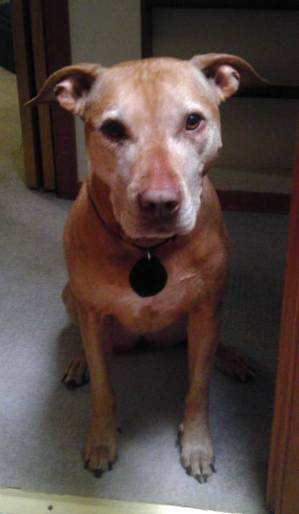
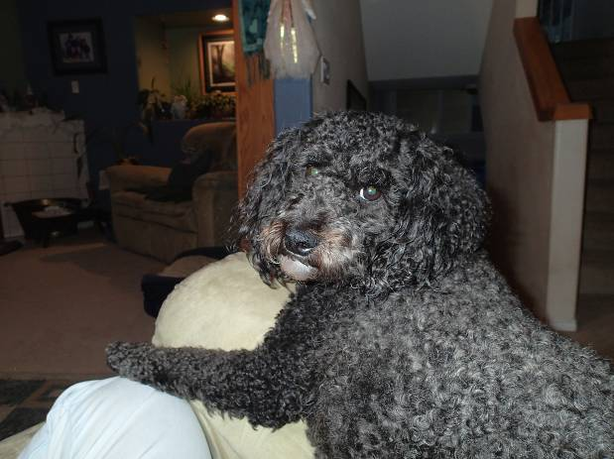
Physical Reactions of Canines
“At one point, the researcher said Sherman sighed and put his head down on his paws, and he physically did do that at that time. A couple times during session Sherman was playing, but then stopped and laid down, like he was thinking or listening.”
“Kelly was lying down in her chair with her sister laying her head on Kelly while we were doing the session. Sometimes she would look around like maybe she was looking for an answer.”

Slide 19
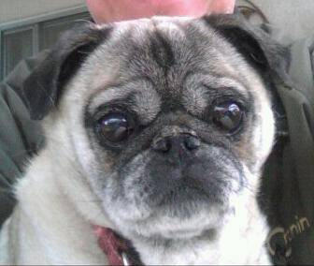
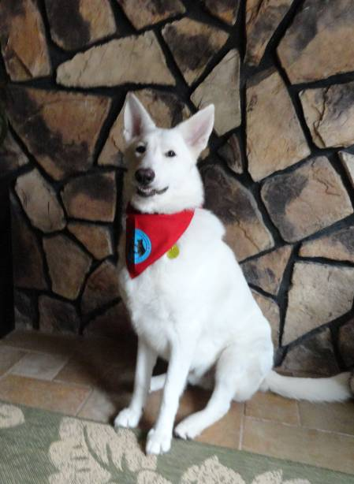
Physical Reactions of Canines
“I noticed that during the session he was very relaxed and would occasionally thump his tail as if to say, “I understand what you are asking.”
She sat on my lap the entire time and did not fall asleep. The first question asked she looked up and stared ahead. I was really watching her to see if these types of things took place.

Slide 20
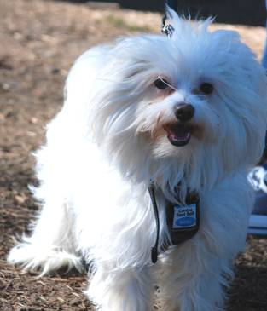
Physical Reactions of Canines
“It was difficult to hear of Landon’s strong dislike towards the rats, and it broke my heart that he was so upset. We had just brought the rats home the night before, so was hoping his strong reaction was curiosity and he would get use to the idea. During the session Landon stared stiffly, like a statue, at the rats, without moving a muscle. At one point, he looked away, like he was listening, but never let his intense obsessing over the rats go, until we moved them to a different room immediately following the session.”

Slide 21
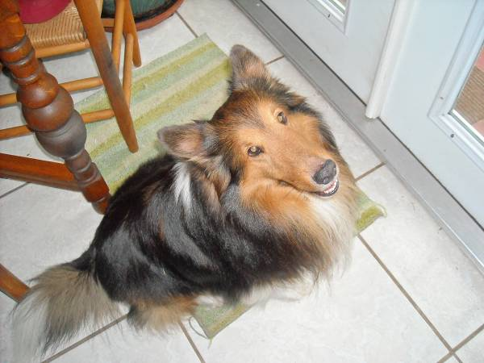
Physical Reactions of Canines
“I am very pleased and when the communication started, I saw a change in him. He looked like he was listening to someone.”
“Right after we did the question about barking, Salem went outside to bark at a truck driving by. I feel that he understands better than or is more willing to comply then Patti.”
“At this moment in the conversation, my very large dog leapt up and threw his upper body into my lap. This is not something he has ever done. It felt like he was really showing his love as he spoke it to you!”

Slide 22
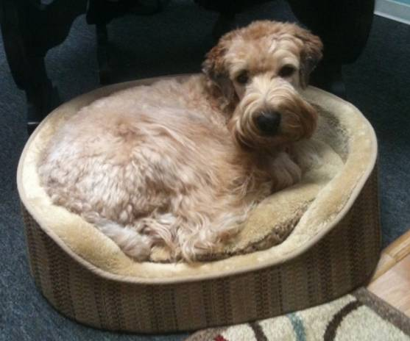
Canine Messages to Guardians
Animal’s response: “I hear everything you think. I feel everything you feel.”
Animal’s response: He “likes the size of the house” as far as the number of dogs. He likes being the boss. He’s very thankful that he landed with you guys and he’s really happy.
Animal’s response: “She should let me help with the healing sessions, she may be surprised.”
Animal’s response: Researcher got an adoring look from Roger: “I adore her. I’m really happy, thank you for taking such good care of me. I have a great life.”

Slide 23
Canine Messages to Guardians
Animal’s response: “It’s going to be fine, it’s going to be better. As long as we’re together, it will all work out.”
Animal’s response: Researcher got that he wants the rats out of the house. “Before the rats came, I had a perfect life.”
Animal’s response: Researcher got that “I know I’ve made you sad” and he’s very sorry about that. He knows he’s been forgiven by guardians but he hasn’t forgiven himself for what happened. “I’ll try to be more respectful of the little ones.”

Slide 24
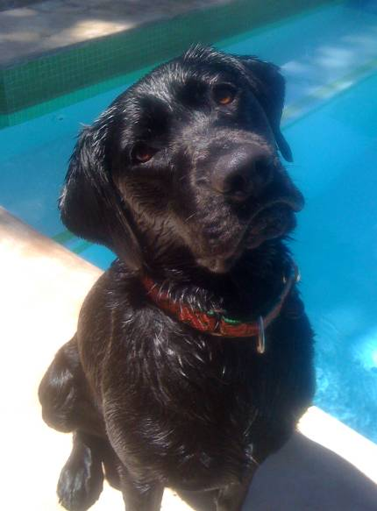
Canine Messages to Guardians
Animal’s response: “Thank you for Dane.” She’s really happy that he’s there. “Thank you for taking such good care of me.”
Animal’s response: “She worries about me too much, I’m fine. She doesn’t need to worry so much. I’m good, we’re good, life is good.”

Slide 25
Limitations
Researcher was the animal communicator and conducted all sessions herself.
No alternative preparation used by researcher other than the described meditation methods.
All 138 potential participants who responded to the recruiting email could not be accommodated.
Guardian gender was almost exclusively female (49 to 1 male).

Slide 26
Limitations
Some participants were known to the researcher (13 of 50 guardians, or 26%).
Participant bias and the truthfulness of data received.
Researcher may have actually received information telepathically from the guardian, rather than the canine. However, researcher has also worked from only a picture of the animal without guardian on a conference call.

Slide 27
Suggestions for Future Research
Future research could expand to other species, such as
  domestic cats (Felis silvestris catus),
  horses (Equus ferus caballus)
  a range of domestic birds (finches, parrots, parakeets, etc.)
  domestic snakes
  ferrets
  rabbits
  chickens

Slide 28
Suggestions for Future Research
Include other methods for human preparation to quiet their mind
  HeartMath program
  mindfulness-based stress reduction
  transcendental meditation
  sonic drumming of a shamanic journey
All of these methods focus on quieting the mind and shifting focus inward, away from the physical world.
It is in this quiet, dark, internal space
that animals can be heard.

Slide 29
Discussion
Findings suggest telepathic interspecies communication may be possible using meditative techniques to quiet the human mind.
Common issues surfaced by guardians related primarily to their canine’s naturally reactive nature.
These common issues represent canine feelings and emotions that are not that different from the complexity of human emotional relationships.

Slide 30
Conclusions
Perhaps the heart, or the heart’s electromagnetic field, may be a contributing source of energy that facilitates telepathic communication with animals.
Jean Huston suggested a divine connection:
“It is not inconsequential that the English language allows for the dyslexia of the spelling of the word dog: God spelled backward.“

Slide 31
Next Research--Equine Therapy:
“There is something about the outside of a horse
that is good for the inside of a man.”
Winston S. Churchhill
PTSD and traumatic brain injury veterans
PATH certified therapists
Two other animal communicators
Blinded design
Horses are particularly well suited to therapy programs for wounded veteran warriors

Slide 32

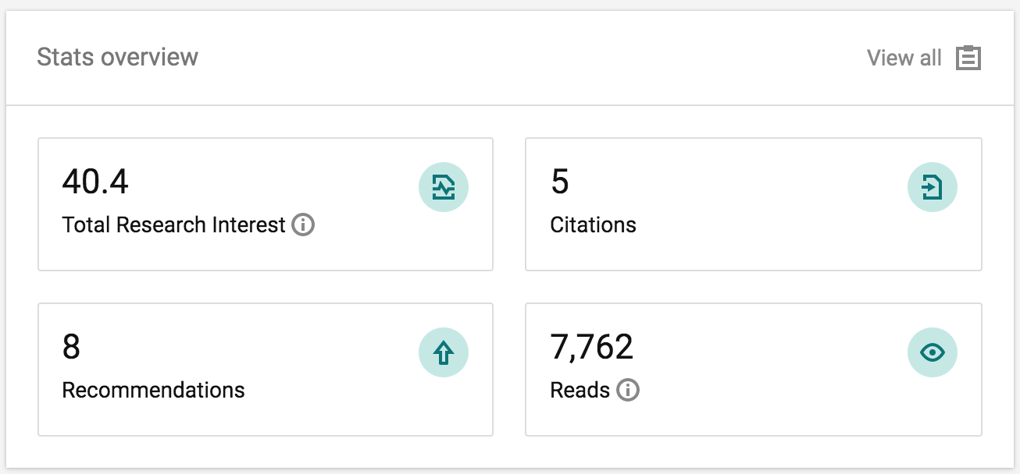

Slide 33
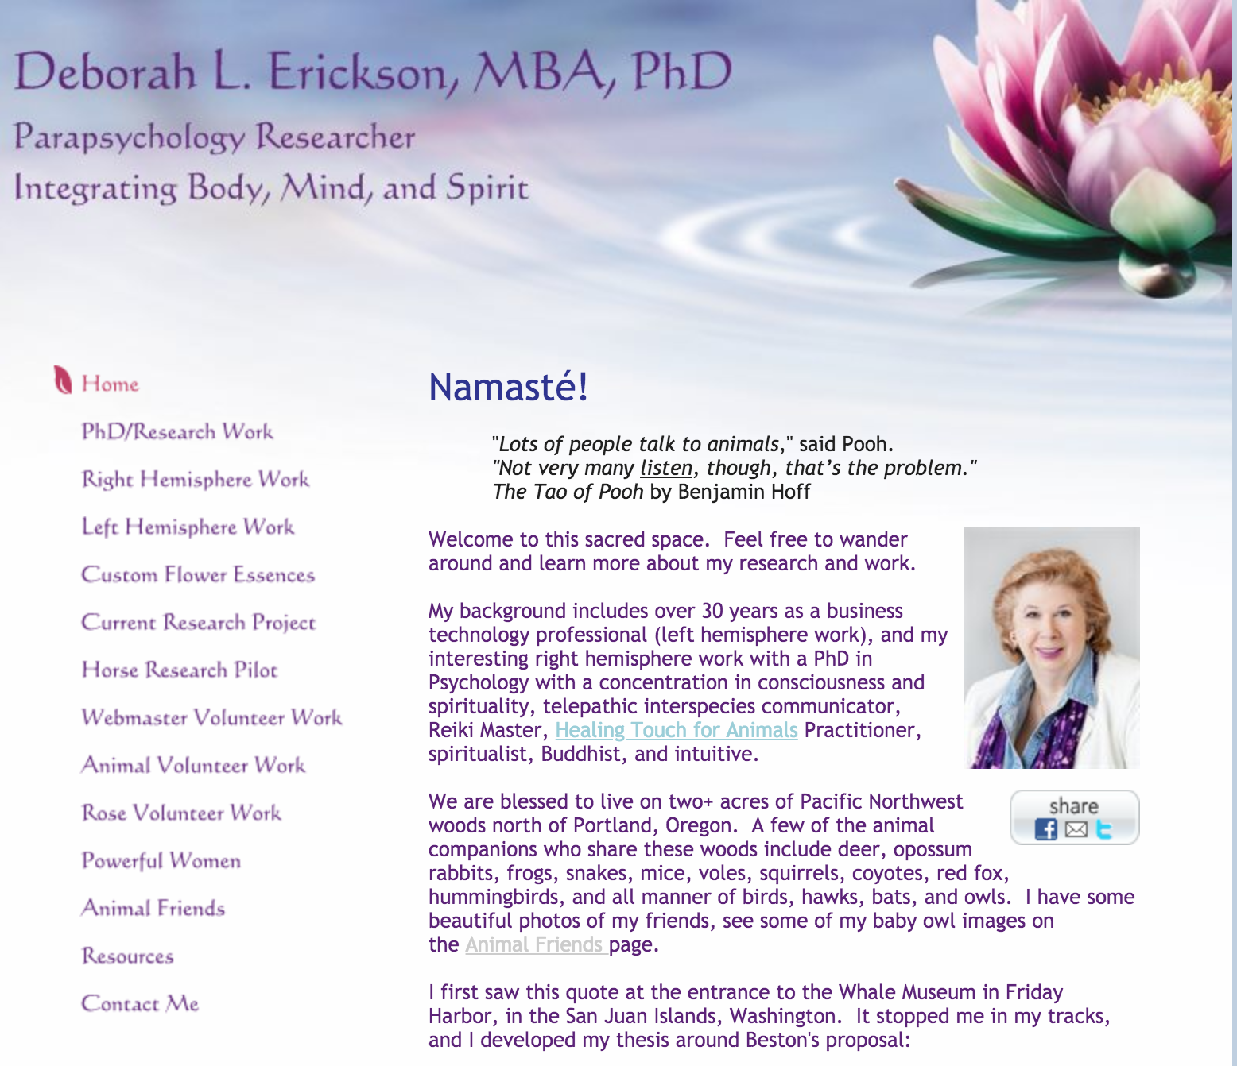

Slide 34
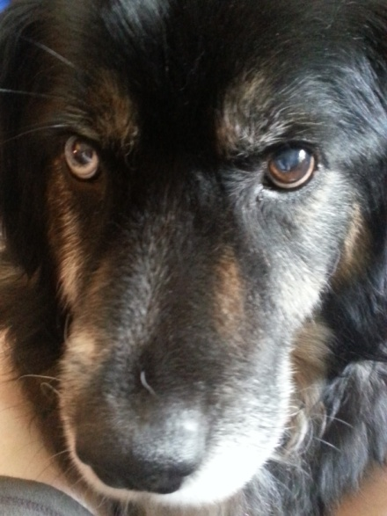
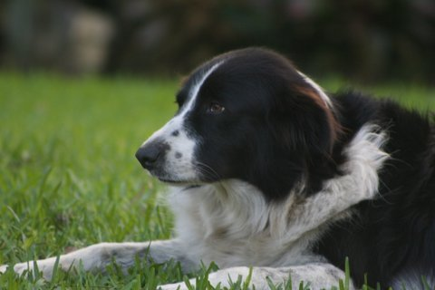
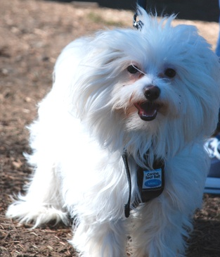
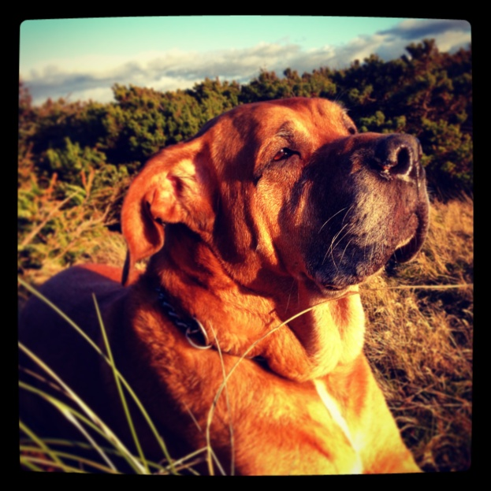
Questions / Comments

Slide 35
A Mixed Methods Exploratory Study of Alleged
Telepathic Interspecies Communication with Domestic Dogs
(Canis lupus familiaris)
Deborah L Erickson, PhD

